Slide 1
Introduction
CS121 Parallel Computing
Spring 2020

Slide 2
Administrivia
Instructor Assoc Prof Rui FAN 范睿 fanrui@shanghaitech.edu.cn / 131-2259-1828
Online “flipped classroom” format
Lecture notes and videos uploaded to course Blackboard 4 days before class.
Students need to study the online lecture material before class.
Online classes held weekly on Mondays & Wednesdays at 3-4:40pm.
During class students and the lecturer will interact and discuss the lecture content.
Additional discussions on course Piazza.
Classes done using the teleconferencing software Zoom.
Download and install Zoom from https://zoom.us/client/latest/ZoomInstaller.exe.
At the start of class, log into Zoom and join meeting ID 364-929-4960.
Students will see live content from the instructor’s computer.
TA Wang Leshan 王乐山
wangleshan1996@outlook.com
Recitation Format and time TBD.

Slide 3
Course assessment
Problem sets | 20%
Labs | 20% | Solve problems using OpenMP and CUDA
Reading project | 20% Teams of 2 | Find an interesting research paper from the suggested reading list. Tell me your paper by week 8 (April 24). Submit a report and 20 minute video about the paper by end of week 16 (June 19).
Course project | 20% Teams of 2 | Find an interesting problem and write an efficient parallel program for it. Tell me your problem by week 10 (May 8). Submit a report and 20 minute video about your project by July 3.
Final exam | 20%
Class participation | May move borderline grades up half a letter grade (e.g. B+ to A-) |  | Actively participate in online class discussions.

Slide 4
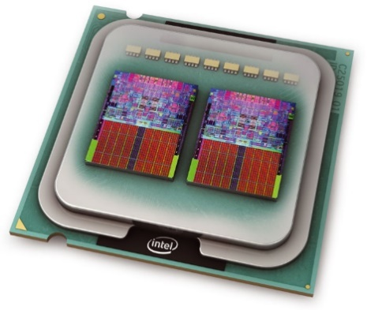
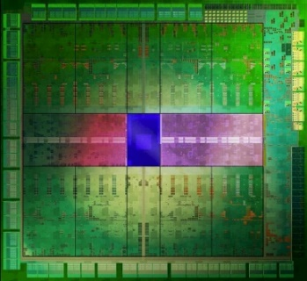
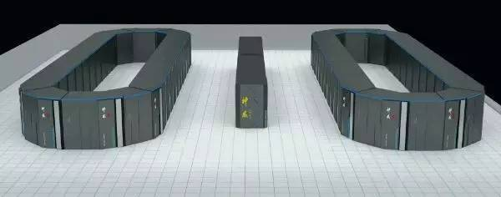
Parallel computing: what and why
Parallel computing studies how to use multiple computers together to solve a problem.
Allows solving complicated problems faster.
Ideally, with k processors we can solve a problem k times faster.
Also more memory to solve larger problems, or same problem with more accuracy.
May be more fault tolerant; but also more prone to faults.
Almost all modern computer systems are parallel.
Multicores, GPUs, cloud computing, etc.
Parallel computing crucial for modern large scale applications, e.g. physical simulations, data minining, machine learning.

Slide 5
Course objectives
To understand the concepts and techniques of parallel computing, and take advantage of the capabilities of modern systems.
Parallel hardware models and interaction with parallel software.
Power and limitations of parallelism.
Efficient parallel algorithms for important problems.

Slide 6
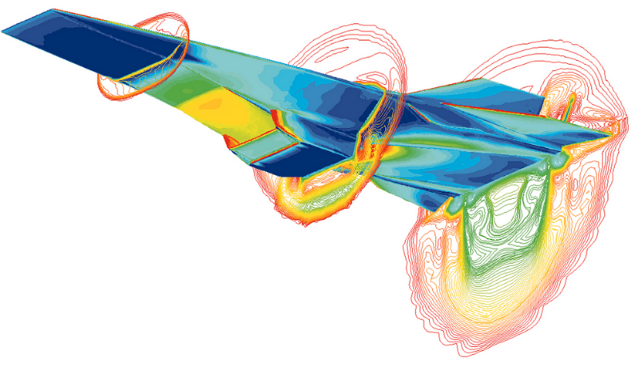
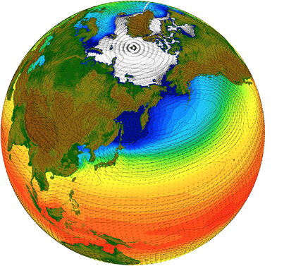
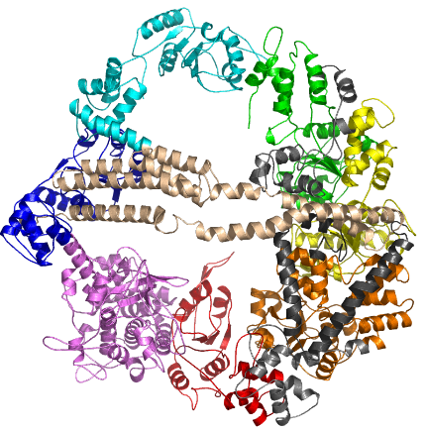
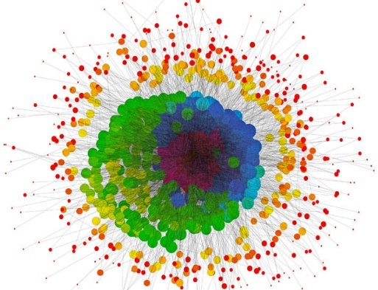

Applications
Fluid dynamics, weather prediction, climate modeling.
DNA, protein, drug structures and interactions.
Quantum / atomic simulations, cosmological simulations.
Cryptoanalysis.
Big data analytics.
Simulating financial and social behaviors.
Machine learning and AI.
Simulating the human brain.

Slide 7
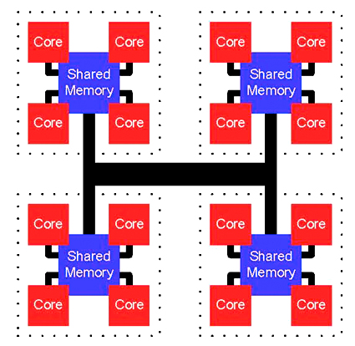
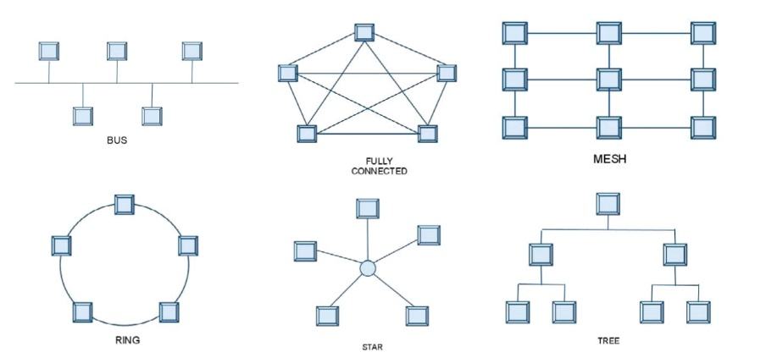
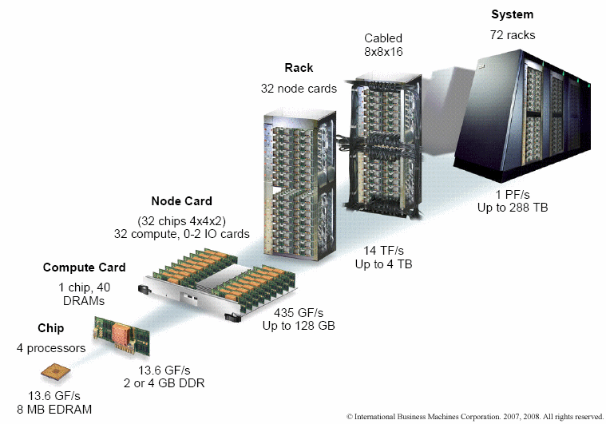
Parallel hardware
Efficient parallel computing requires synergy between parallel hardware and software.
Parallel system consists of multiple independent processors communicating over an interconnect.
Unlike sequential (von Neumann) architecture, many parallel hardware designs.
Different types of processors (multicores, manycores, FPGA, etc.).
Heterogeneous designs combine multiple architectures, e.g. multicores and GPUs.
Different interconnect designs.
Communicate through shared memory, or message passing over network.
Parallelism exists at many layers.
Instruction, core, chip, node, rack, etc.

Slide 8
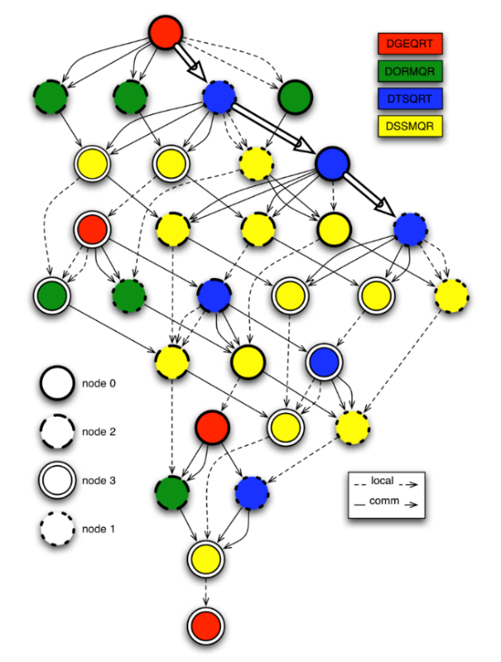
Parallel software
Break a large problem into subproblems (tasks) that can be solved (somewhat) independently.
OS and scheduler allocate tasks to different processors.
Respect dependencies between tasks.
Parallel software must be matched to the hardware.
Similar amounts of concurrency in software and hardware.
Hardware must adequately handle software communication pattern.
No single hardware model suffices.
Parallel software is often not portable.
PRAM model tries to abstract parallel hardware.
Useful for understanding inherent parallelism.
Unrealistically discounts cost of communication.

Slide 9
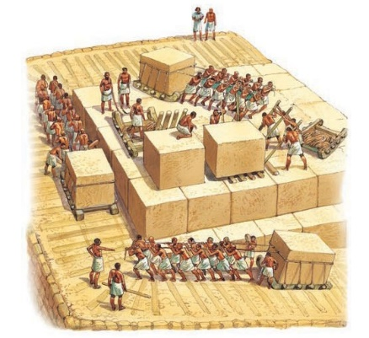

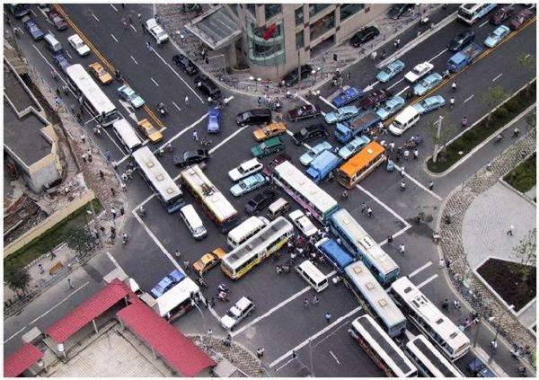

Challenges
Harnessing power of the masses.
Easier said than done...
Communication
Processors compute faster than they can communicate.
Problem gets worse as number of processors increases.
Main bottleneck to parallel computing.
Synchronization
Tasks may interfere with each other, so can’t be done at same time.
Scheduling
Track and enforce dependencies.
Find good allocation of tasks to processors.
Data locality, heterogeneous processors
Maximize utilization and performance.

Slide 10



Challenges
Structured vs unstructured
Structured problems can be solved with custom hardware.
Unstructured problems more general, but less efficient.
Inherent limitations
Some problems are not (or don’t seem to be) parallelizable.
Ex Dijkstra’s shortest paths algorithm.
Other problems require clever algorithms to become parallel.
Ex Fibonacci series (a_{n} = a_{n-1} + a_{n-2}).
The human factor
Hard to keep track of concurrent events and dependencies.
Parallel algorithms are hard(er) to design and debug.

Slide 11
Course outline
Parallel architectures
Shared memory
Distributed memory
Manycore
Parallel languages
OpenMP, MPI, CUDA, MapReduce
Algorithm design techniques
Decomposition, load balancing, scheduling
Parallel algorithms
Dense and sparse matrix algorithms, sorting, search, graph algorithms, PRAM algorithms, etc.

Slide 12
A brief history
Research and theory started in the early 60’s.
Cray-1 reached 160 MFLOPS in 1976.
Commercially successful supercomputers (Cray, Thinking Machines, etc.) started in 1980’s.
Used expensive custom processors.
In 1990’s massively parallel processors (MPPs) and clusters became dominant.
MPPs use commercial (OTS) processors with custom interconnects.
Clusters use OTS processors and interconnects running Linux.
Cheap, easy to build and relatively powerful.
Most data centers today are clusters.
Fastest supercomputer today is IBM Summit MPP.
Runs at 148 PFLOPS, about 1M times faster than a workstation.
Apart from supercomputers, progress in parallel computing stalled in 1990’s until mid 2000’s.

Slide 13
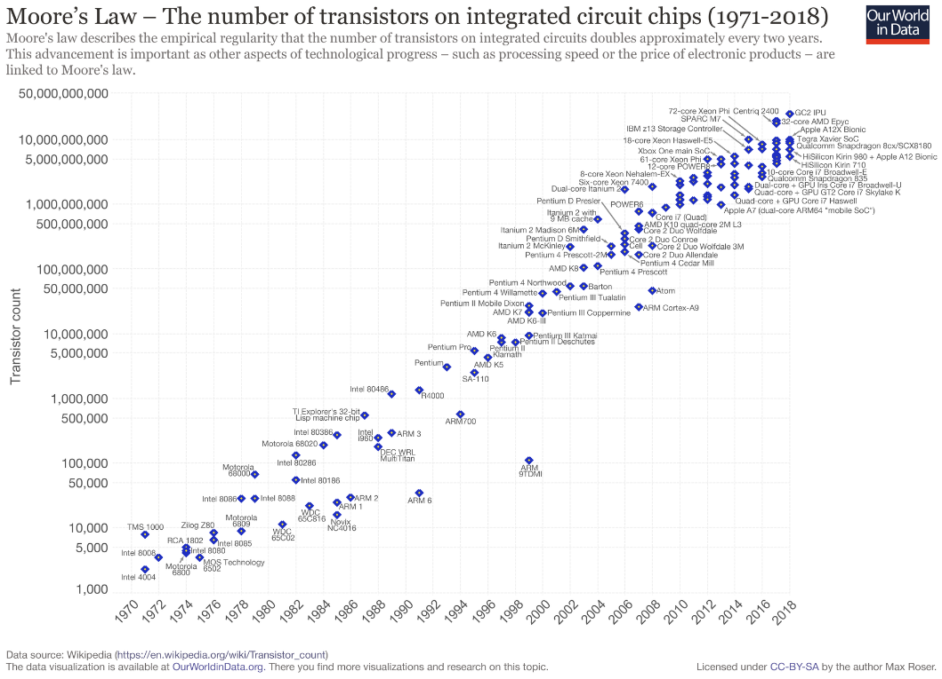
Moore’s Law and parallel computing
In 1965, Gordon Moore, co-founder of Intel, predicted transistor count would double every 18 months.
Held true for the last 50 years!
Until mid 2000’s, this implied single processor performance doubled at same rate.
This held back development of parallel computers, since in the time to develop one, single processor performance would improve dramatically.
But since ca. 2005, parallel processing has become essential to taking advantage of Moore’s Law.

Slide 14
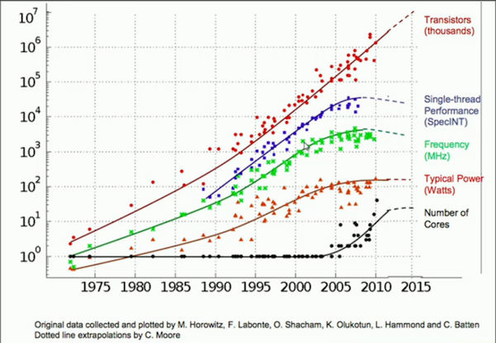
Moore’s Law and performance
Transistor properties, e.g. size and clock speed, do not scale equally.
Higher single processor clock speeds is increasingly difficult to achieve.
Heat
Power consumption
Current leakage

Slide 15
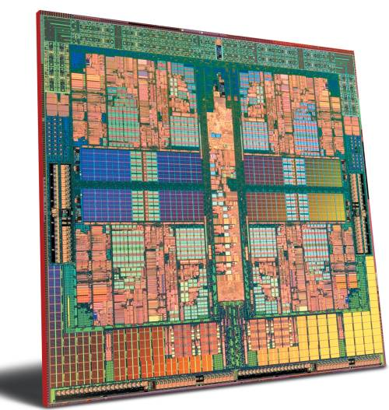
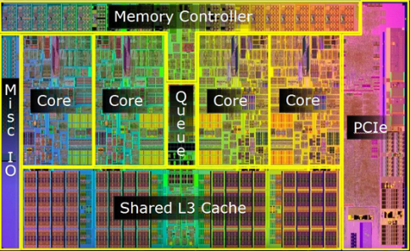
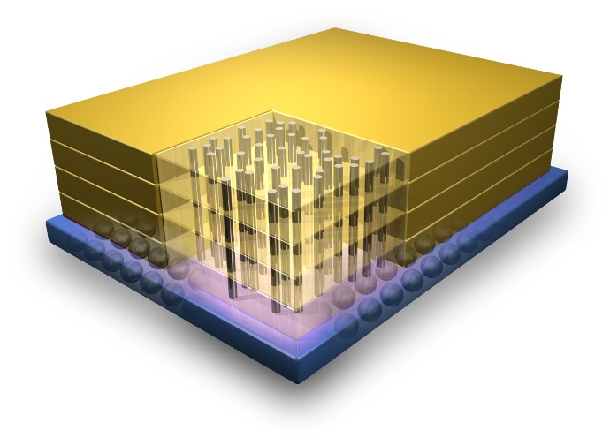
Moore’s Law revisited
Multicore technology addresses (lack of) clock speed scaling.
Link multiple processing cores together on same chip.
More efficient to replace a single high speed processor with multiple slower processors.
Another approach is to stack chips in a 3D structure.
Developing software for multicores has been harder than scaling hardware.
Software developers with parallel computing skills are in high demand.

Slide 16
The state of the art
Parallel computers today mainly based on four processor architectures.
Multicores
Small / moderate number (≤ 64) of fast, general purpose cores.
Ex Intel Xeon, IBM Power, Sun SPARC.
Manycores
Large number (1000’s) of simple cores.
Ex Nvidia Pascal GPU, Intel Xeon Phi, Sunway SW26010.
FPGA (field programmable gate arrays)
Reconfigurable hardware customized for specific problems.
ASIC (application specific integrated circuits)
Specially built hardware for specific problems.
Ex Google TPU, Apple Neural Engine, IBM TrueNorth.
In addition to processing speed, energy efficiency also increasing important.
Biggest datacenters consume over 100 MW of power, ~ 50K homes.
Biggest supercomputers consume ~ 20MW of power.
Goal is a supercomputer achieving 50 GFLOPS / W.
Current supercomputers achieve 1-6 GFLOPS / W.

Slide 17
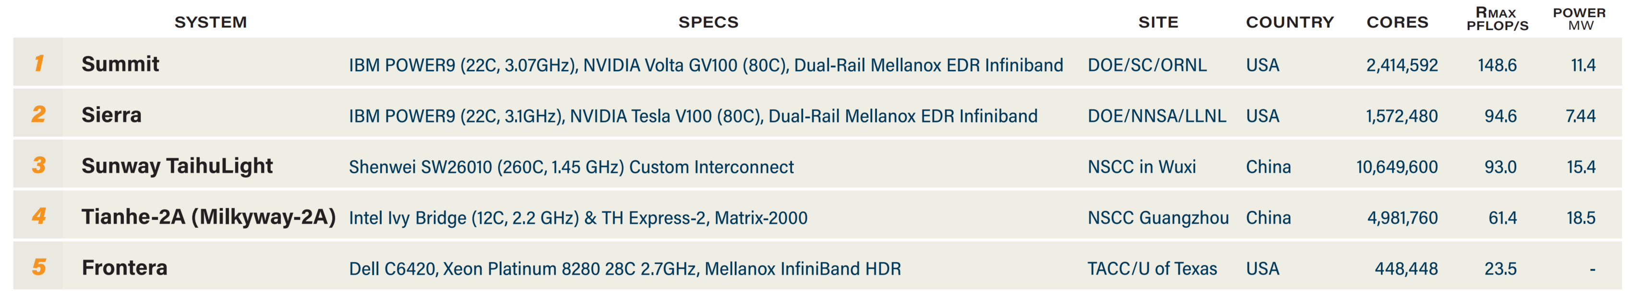
Top 500 list
Biannual ranking of fastest 500 supercomputers in the world.
Speed measured in floating point operations per second.
Uses high-performance LINPACK to solve a dense linear system Ax = b.
Compute intensive, but doesn’t stress memory system.
May not represent performance on real-world problems.
Latest list from November 2019.
For comparison, Intel multicore achieves ~50 GFLOPS / core, and GPU achieves ~ 10 TFLOPS / board.
Mega | Giga | Tera | Peta | Exa
10⁶ | 10⁹ | 10¹² | 10¹⁵ | 10¹⁸

Slide 18
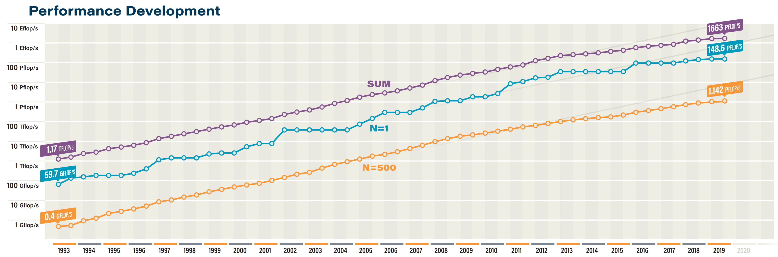
Top 500 – Trends

Slide 19
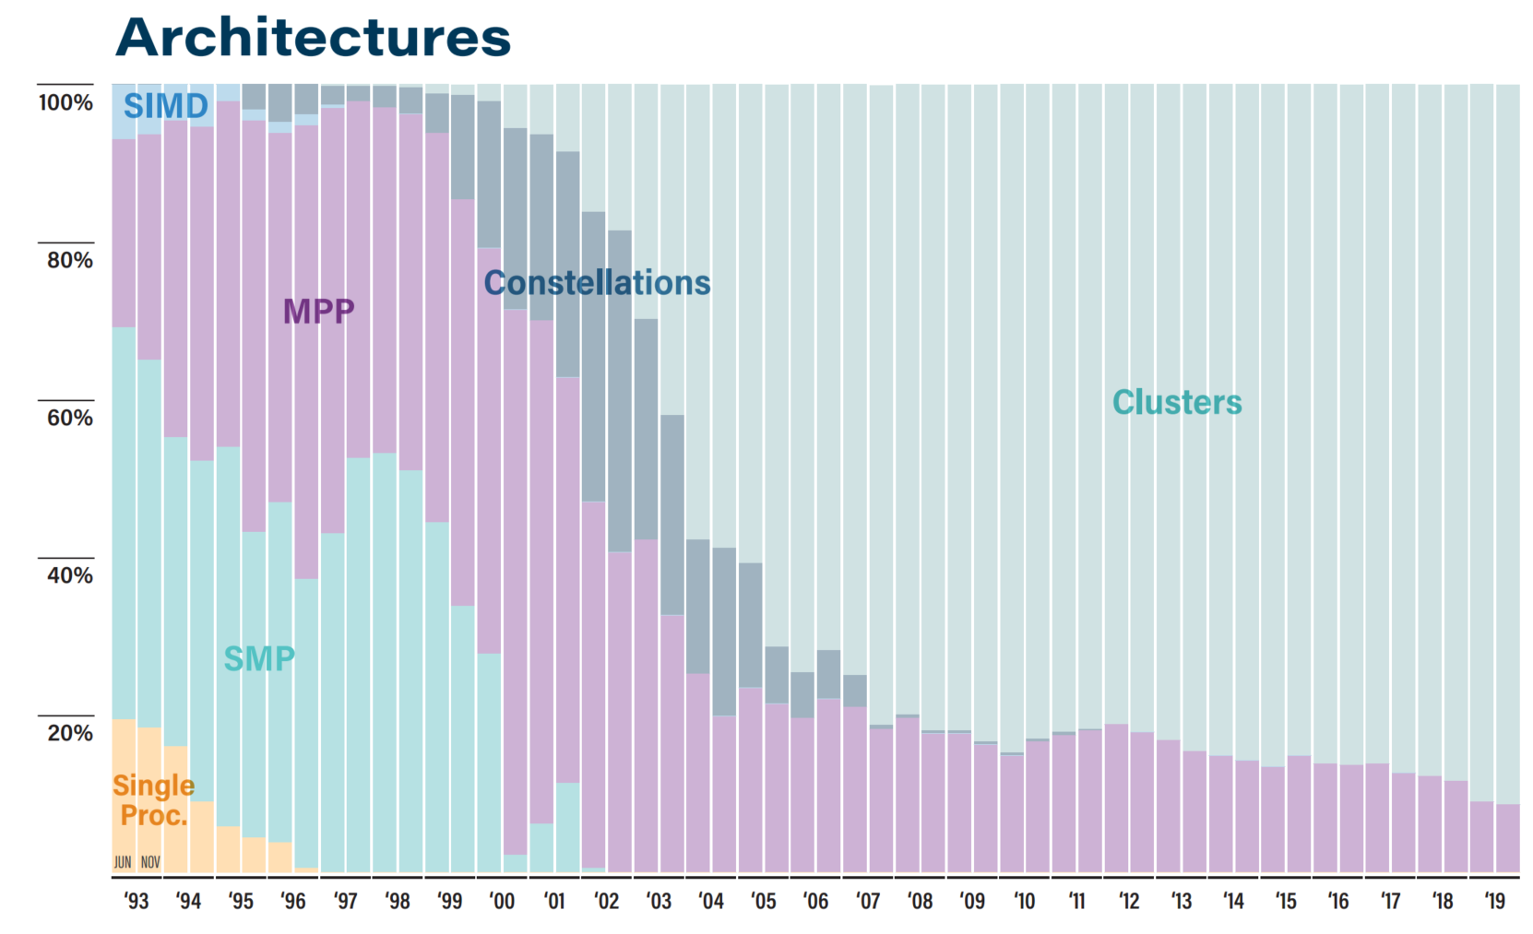
Top 500 – Architecture

Slide 20
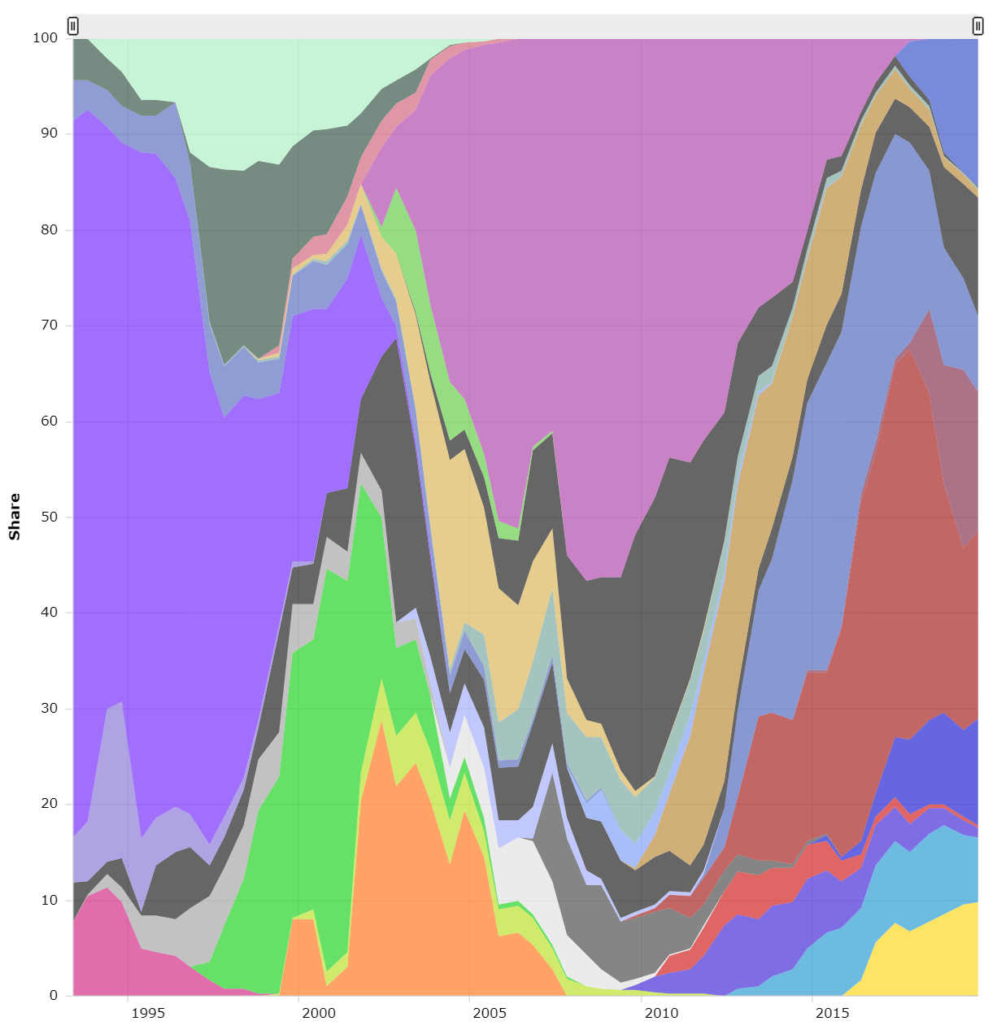
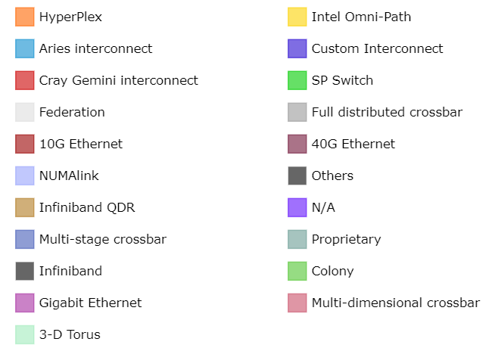
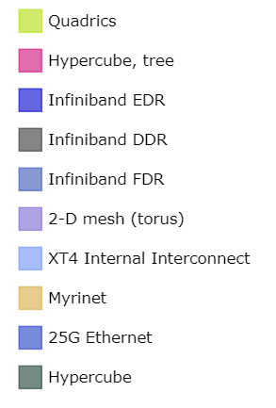
Top 500 – Interconnect

Slide 21
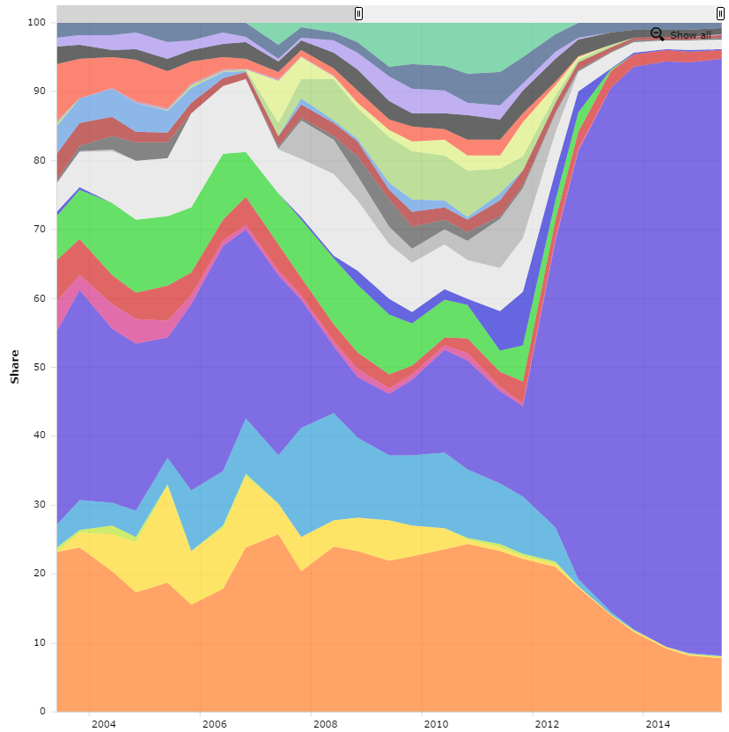
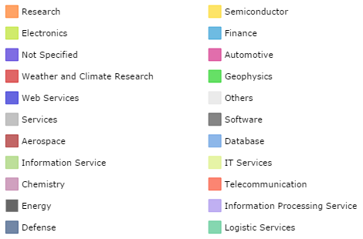
Top 500 – Applications

Slide 22
Other performance measures
LINPACK does compute-intensive operations on structured dense matrices.
Uniform control flow, predictable and coalesced memory accesses.
Ideal for physical simulations.
Data-intensive applications today have instruction divergence, branching and random memory accesses.
New benchmarks give more complete performance picture
HPCG performs sparse matrix operations.
Graph500 performs breadth-first search.
A computer’s performance can differ dramatically depending on benchmark.

Slide 23
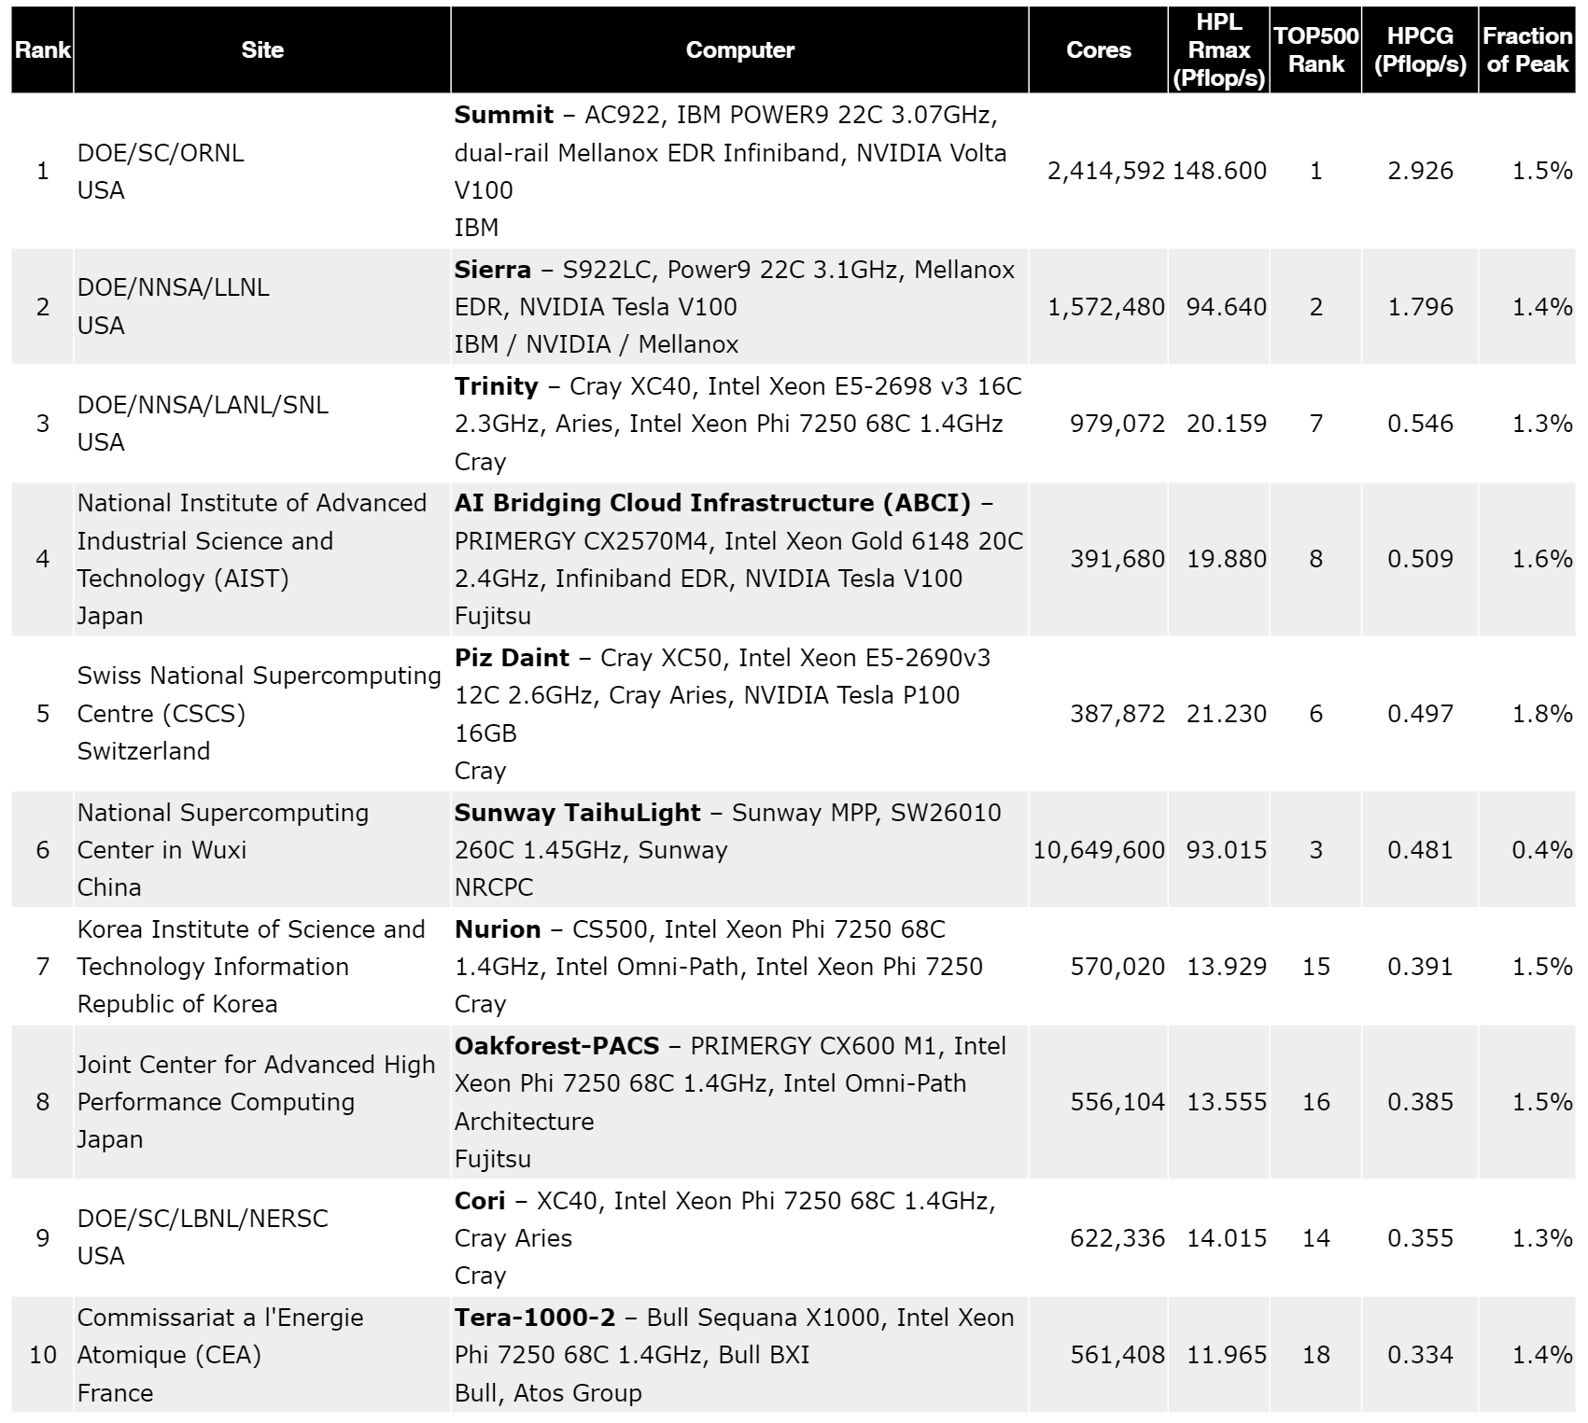
HPCG

Slide 24
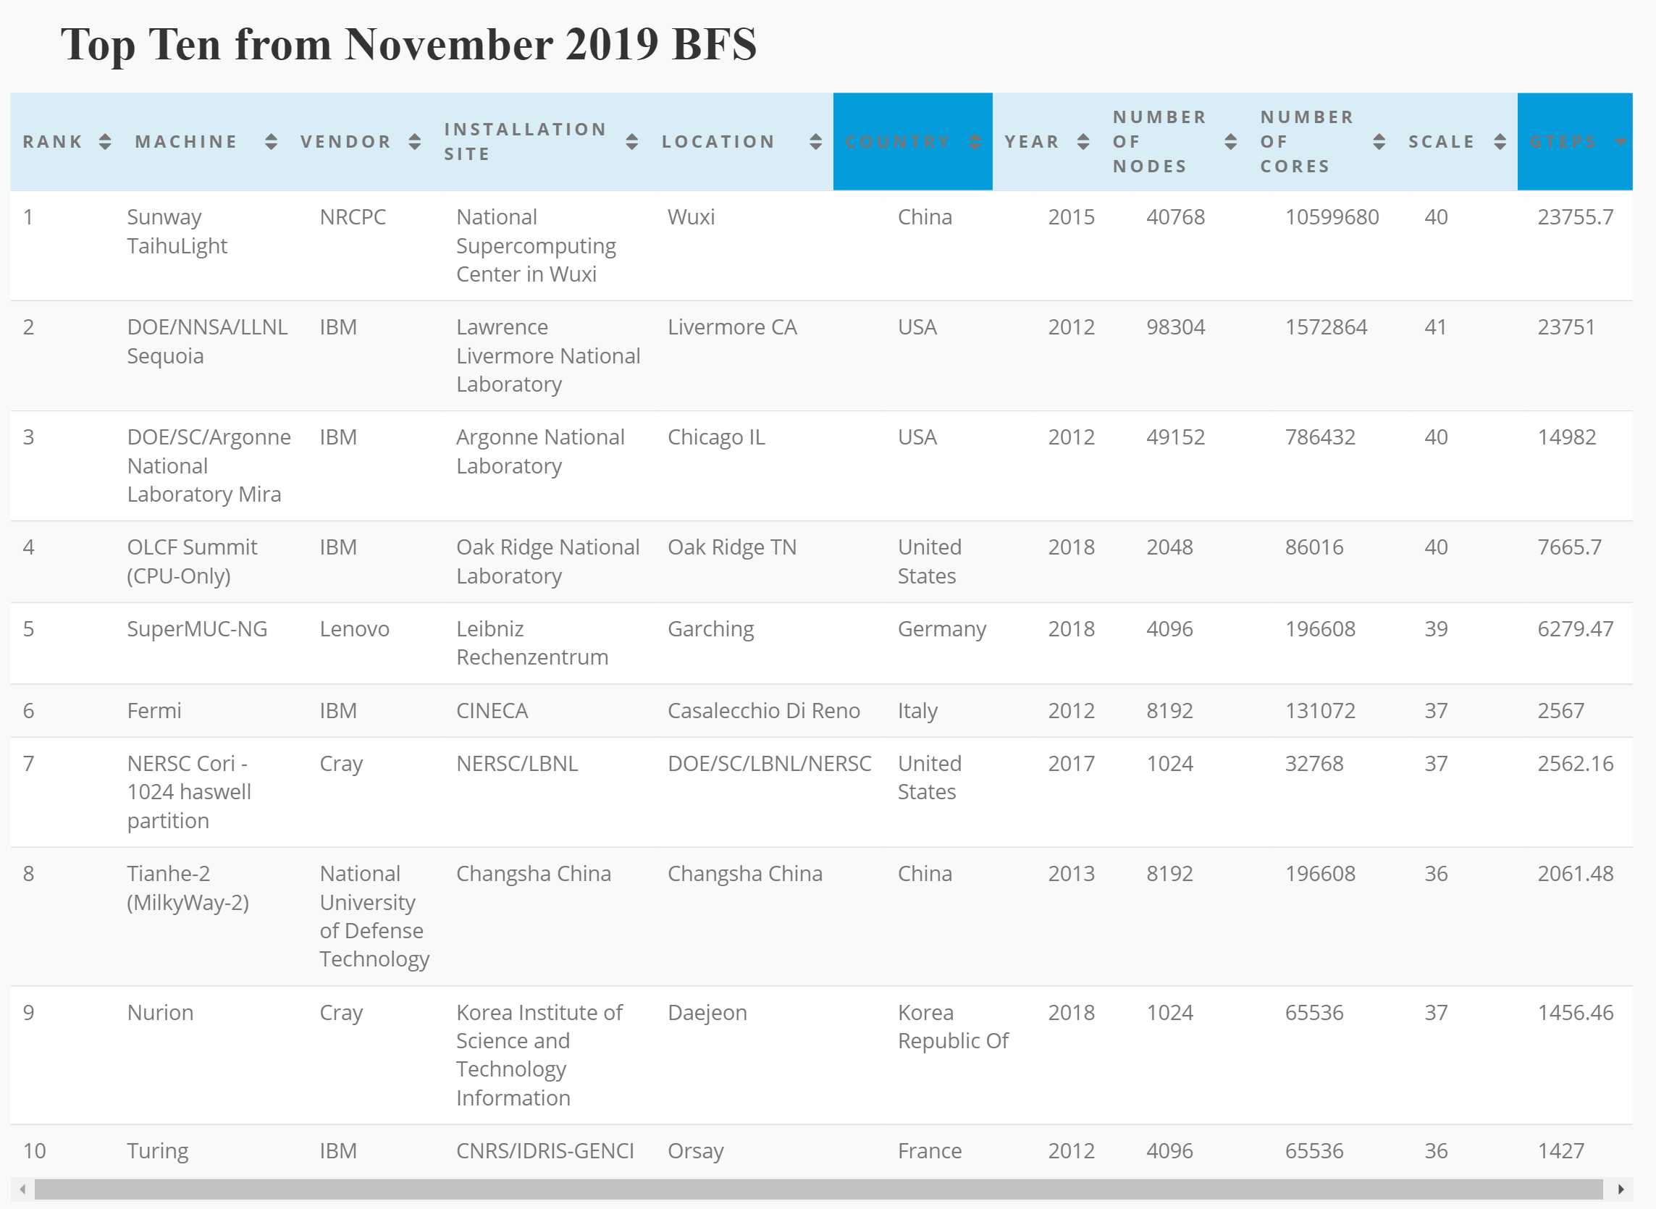
Graph500

Slide 25
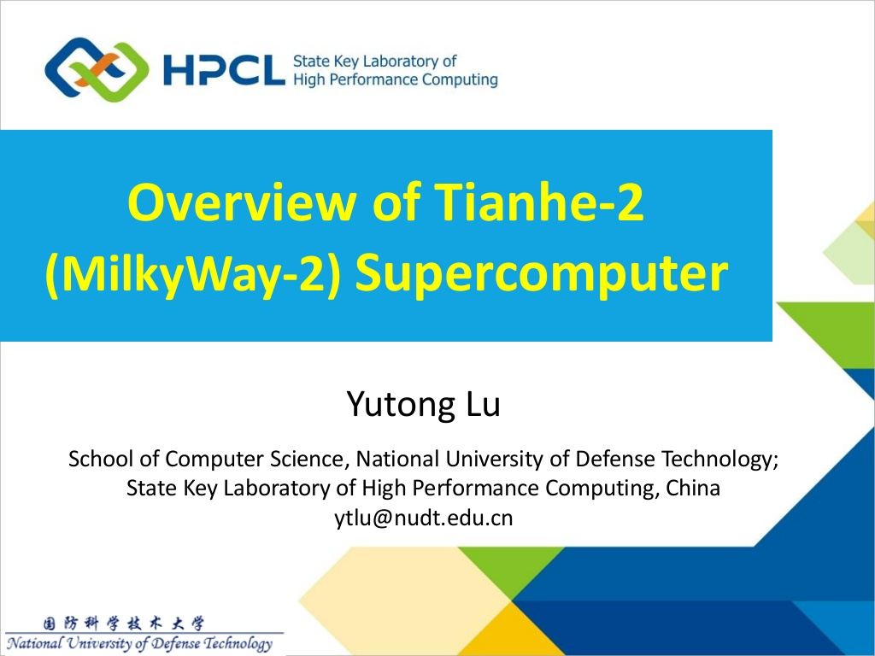

Slide 26
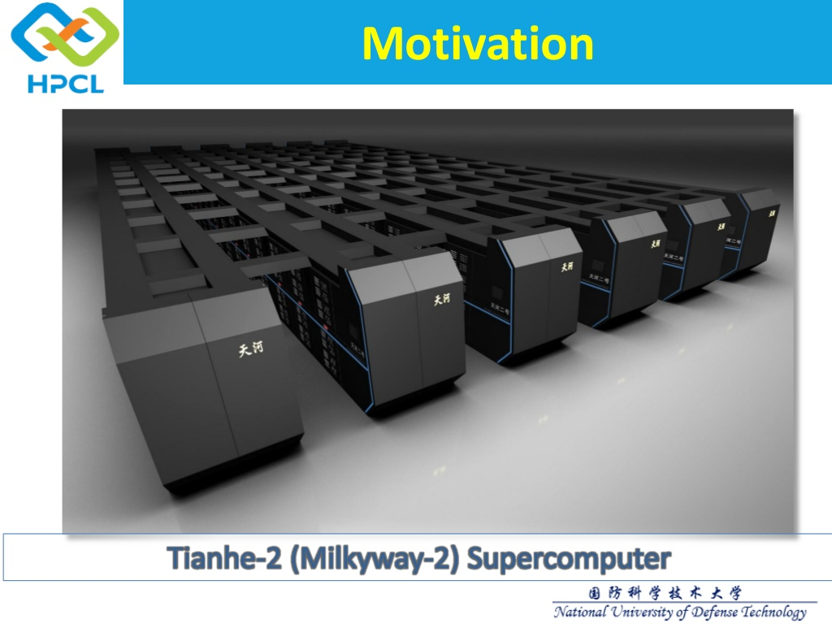

Slide 27
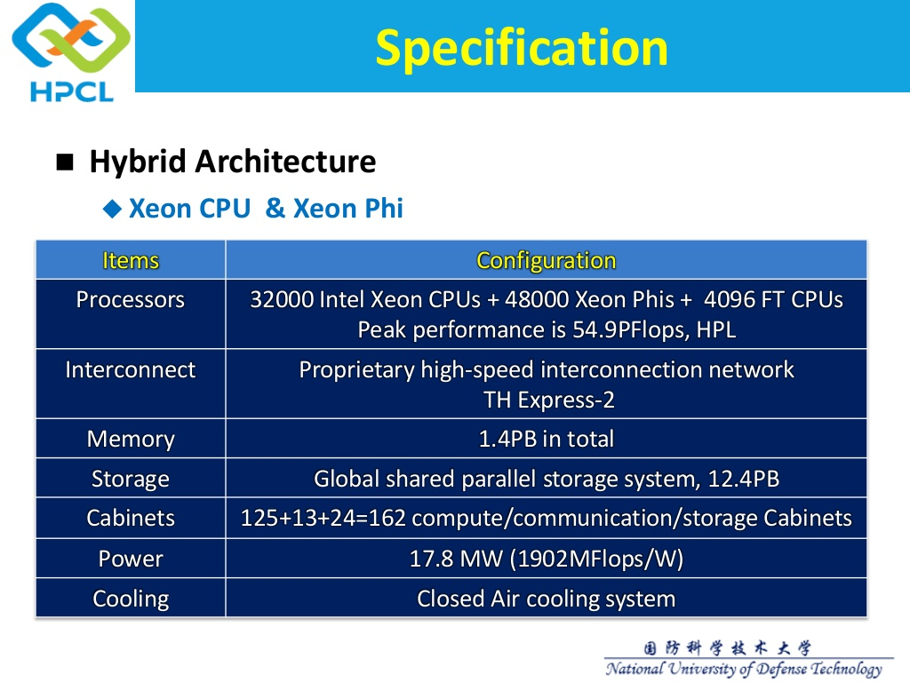

Slide 28
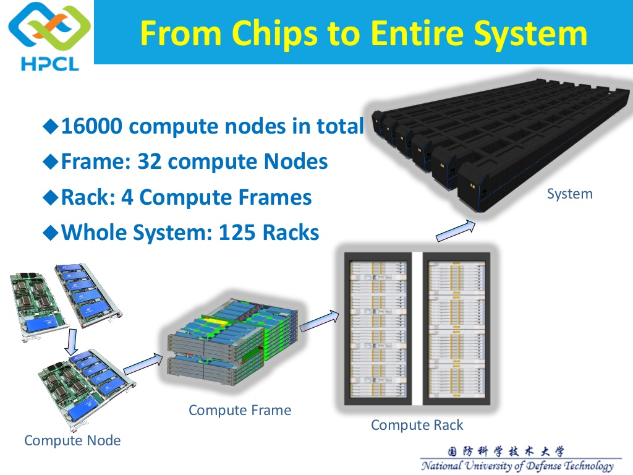

Slide 29
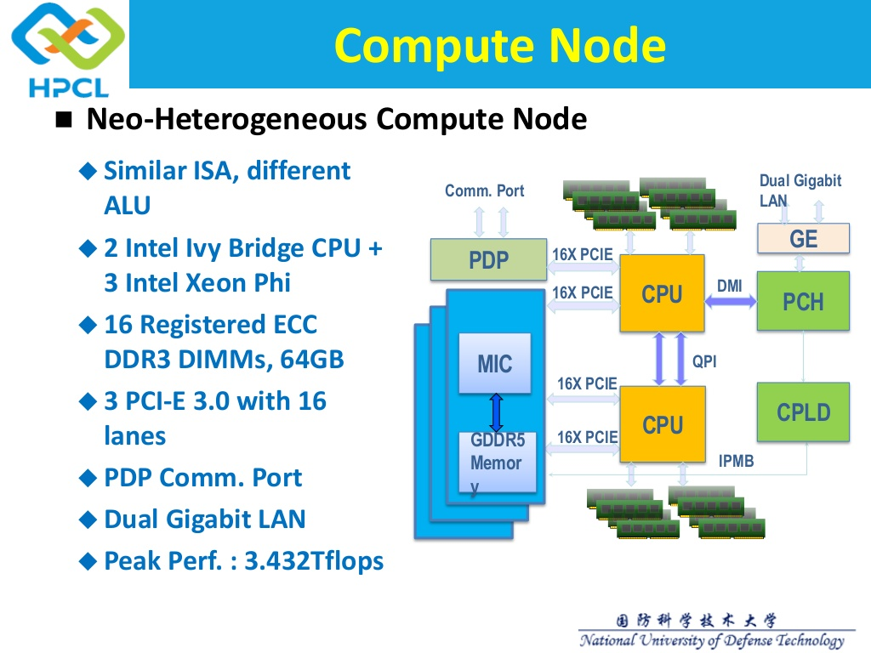

Slide 30
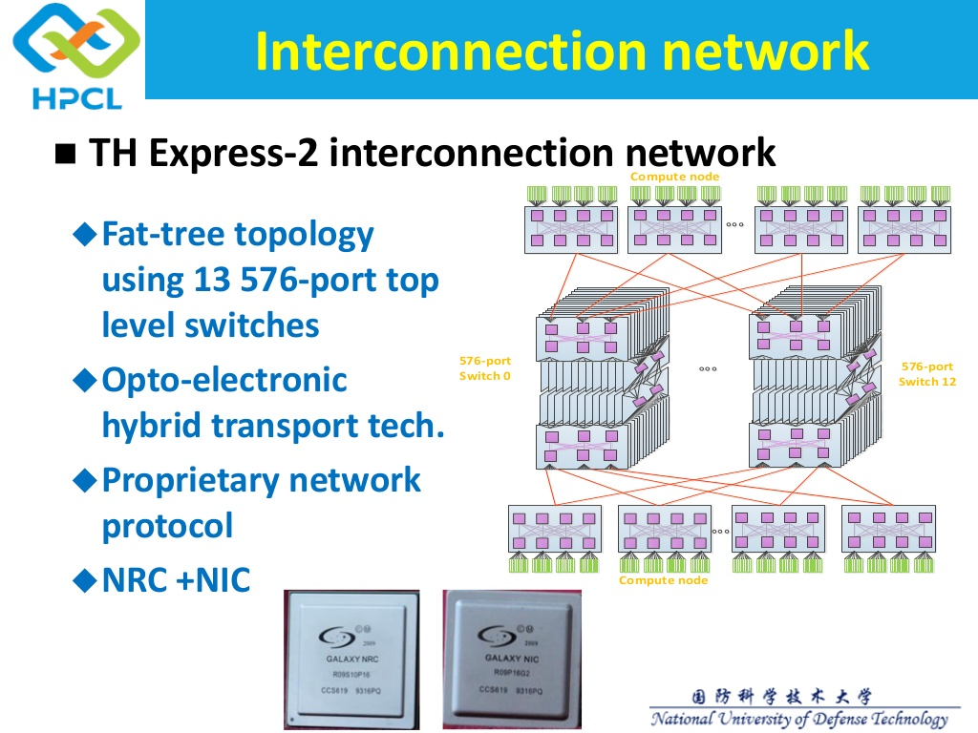

Slide 31
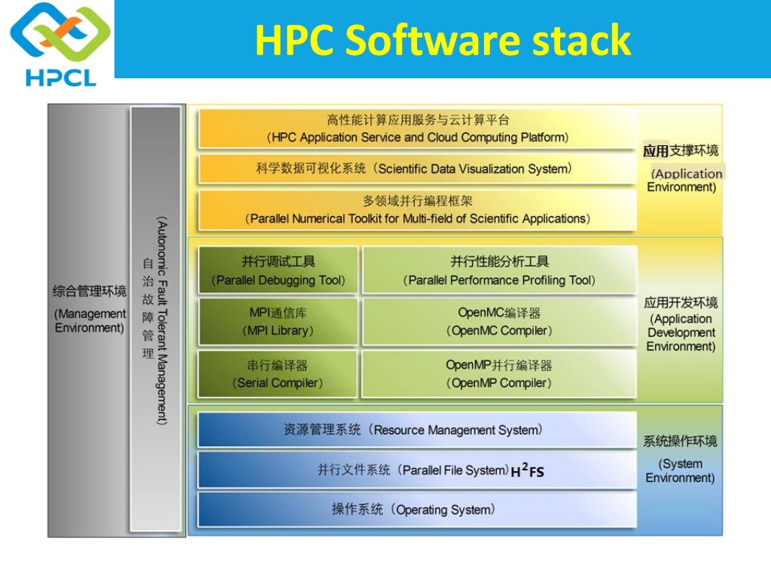

Slide 32
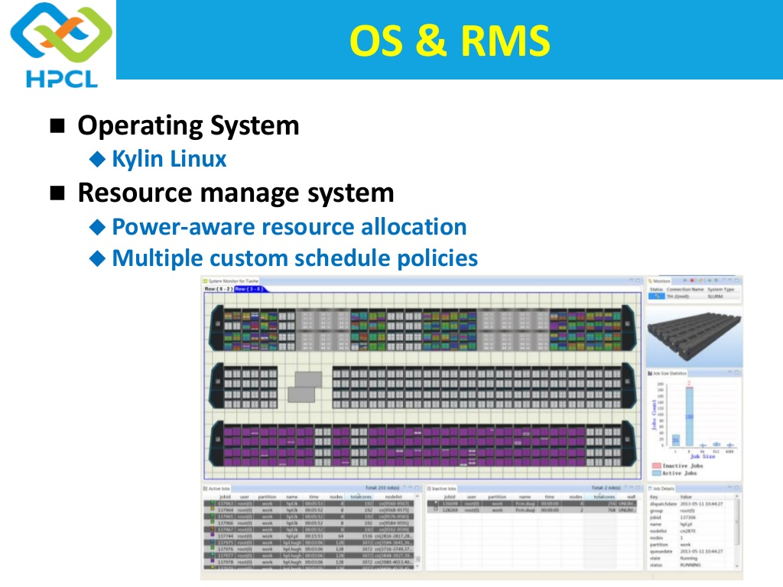

Slide 33
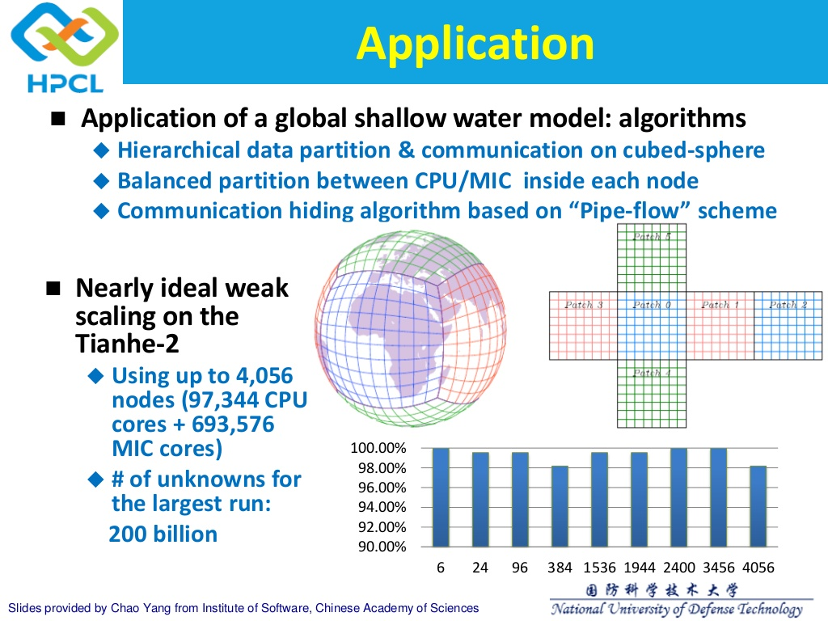

Slide 34
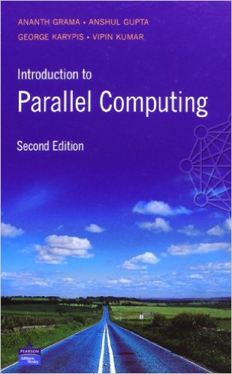
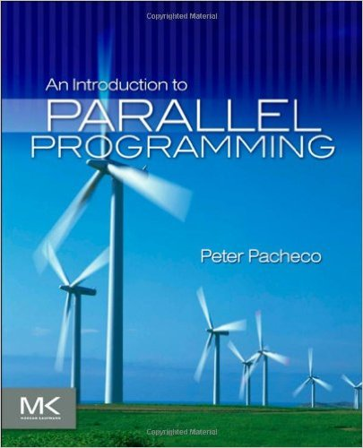
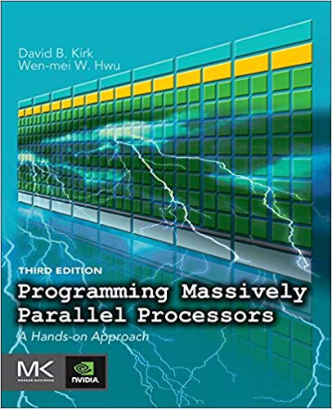
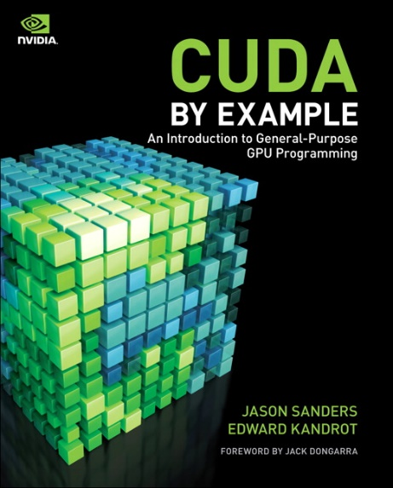
Course texts
Course materials partly taken from the following texts.
But all topics covered by lecture slides.
Introduction to Parallel Computing. Grama, Karypis, Kumar, Gupta. Pearson, 2003.
An Introduction to Parallel Programming. Peter Pacheco. Morgan Kaufmann 2011.
Programming Massively Parallel Processors. Kirk, Hwu. Morgan Kaufmann 2016.
CUDA by Example. Sanders, Kandrot. Addison-Wesley 2010.

